Slide 1
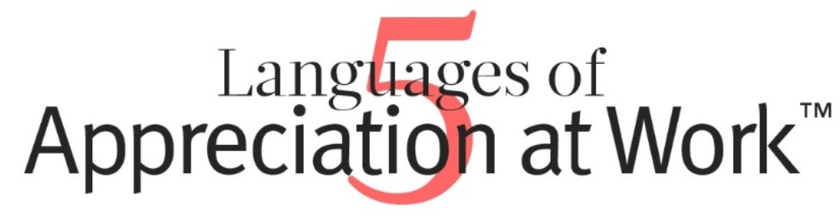
Empowering Organizations by Encouraging People
Gary D. Chapman
Paul E. White
2018 DOVIA Annual Conference
November 2, 2018
Notes:
Thank you for having me today, we are happy to highlight some of the ideas behind the book “Empowering Organizations by Encouraging People” by Gary D Chapman & Paul E White.
For our purposes today, we could interchange employer/employee with volunteer.

Slide 2
In the past a leader was a boss. Today's leaders must be partners with their people... they no longer can lead solely based on positional power.
Ken Blanchard
Read more at http://www.brainyquote.com/quotes/keywords/boss.html#jOJWocOGTHO4Mbr6.99
Notes:
In leading volunteers you can’t lead them through a position of power. You lead them by sharing your vision and passion for the organization you are representing.

Slide 3
Do you feel satisfaction in the work you do?
You enjoy the work you do each day
Your job is just a means to keep food on the table
Notes:
All of us expect to be paid for our work and yes, we would all like to make more money, but there is one factor that tops pay… Your volunteers show that they do what they do not for monetary reasons but they are intrinsically motivated.

Slide 4
Two key factors to retaining good volunteers…
Recognition
Engagement
Notes:
A survey conducted by the Society of Human Resource Management shows that..

Slide 5
Americans who leave their jobs say they do so because they do not feel appreciated.
64%
Notes:
According to research conducted by the US Department of Labor
% includes employees across the board, from CEOs to housekeeping staff.
Something deep within the human psyche cries out for appreciation and when it is not met then job satisfaction will be diminished.
Comments from employees:
“It’s not about the money. It’s just that, not what I do – how long I work or what I accomplish – I never hear anything positive. If I make a mistake, I hear about it immediately, but if I do my job well, there is silence.”
“If my boss lifted one finger to help me get something done, I’d fall over and die from a heart attack” Even joking her tone had an edge
“Mr. Jones is positive and encouraging to us. He frequently tells us that we are doing a good job – both individually and as a team. You couldn’t get me to go work for any other office, no matter how much you paid me.”

Slide 6
Why is appreciation important?
Each of us wants to know that what we are doing matters
Without a sense of being valued by the organizations volunteers work with, volunteers start to feel like a machine or commodity
Notes:
Steven Covey feels so strongly about people’s need for appreciation that he states “Next to physical survival, the greatest need of a human being is psychological survival, to be understood, to be affirmed, to be validated, to be appreciated.” (From The 7 Habits of Highly Effective People)
To retain volunteers, they need to feel valued, affirmed and appreciated. Every person has something to contribute.

Slide 7
When relationships are NOT nurtured by a sense of appreciation…
VOLUNTEERS…
will tend to become discouraged, feeling “There is always more to do and no one appreciates what I am doing”
begin to complain about their work, their colleagues, and their supervisor
start to think about leaving the organization and search for new opportunities
Notes:
Your organization would realize very quickly if relationships where not nurtured, because your volunteers would simply quit volunteering.

Slide 8
Why “Just Say Thanks” Doesn’t Work
Recognition
About the employees behavior
Improving performance
Appreciation
Performance plus the employee’s value as a person
Focuses on what is good for the company
Focuses on what is good for the company
Focuses on what is good for the person
Notes:
About Behavior – Catch them doing what you want and your recognize it
Good for company & person – may mean helping them find a position that is better for them than their current role

Slide 9
Recognition
Notes:
?Looking at this pyramid, where do you think leadership lies?
The relational direction of recognition is top-down, coming from leadership…
Trying a general “just say thanks” campaign across the organization would quickly loss impact and can actually backfire, sparking cynicism and sarcasm…
We want even the paid staff showing appreciation to the volunteers and a volunteer will feel appreciated if the paid staff they are volunteering with is feeling appreciated.

Slide 10

Appreciation
Notes:
Appreciation can be communicated from any direction. Colleagues can encourage and support one another at anytime.

Slide 11
APPRECIATION = ENGAGEMENT
Notes:
People want to encourage and show appreciation to those they work with regardless of their role in the organization.
The principles can apply regardless of the type of formal positional relationship you have with others.
The single highest driver of engagement, according to a worldwide study conducted by Towers Watson, is whether or not workers feel their managers are genuinely interested in their wellbeing.
?So what are some ways you get to know your volunteers?

Slide 12
Good News
When leaders actively pursue communicating appreciation to their team members both as a team and individually, the whole work culture improves.
Notes:
This is from Buckingham and Clifton’s Now, Discover Your Strengths: “To excel as a manager, to turn your people’s talents into productive, powerful strengths, requires an additional all-important ingredient. Lacking this ingredient…you will never reach excellence. The all-important ingredient is individualization.”

Slide 13
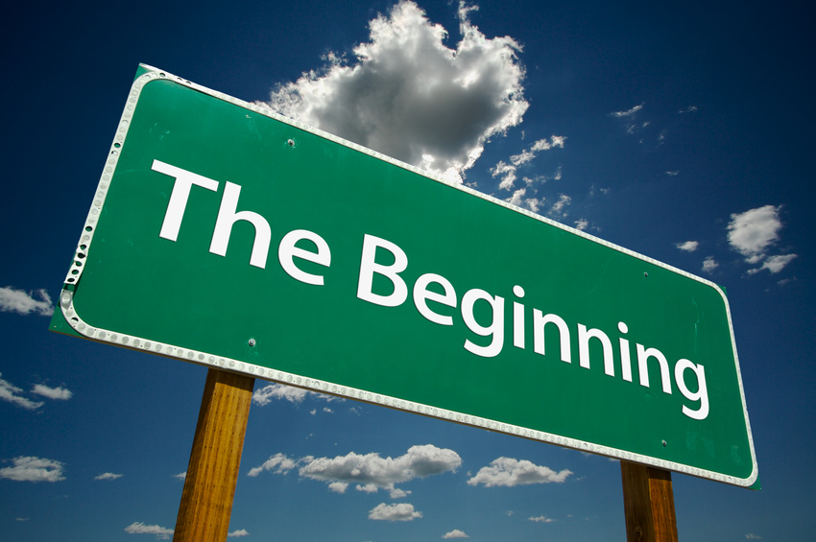
The Flaw
Start with the Golden Rule
  Do unto others as you wish done for you
But don’t stop there…
Notes:
Don’t assume just because you like to be treated one way that everyone else does too.
?Has anyone done the Myers & Briggs Type Indicator or a DiSC assessment???? Does everyone communicate the same way? No, they don’t everyone has their own style. That’s what makes them unique and valuable.
So take it a step further, wouldn’t it be great if you knew how your volunteers want to be treated…

Slide 14


Ellen
Sandy
Bob
Notes:
If you are not showing appreciation in someone’s language, you could cause a variety of feelings from them…
Embarrassment – Ellen’s primary language of appreciation is Quality Time, but she is frequently brought in front of a crowd given Words of Affirmation…she is completely embarrassed by this public recognition
Anger – Bob’s primary language of appreciation is Words of Affirmation, but his supervisor keeps bringing him trinkets…he is angry that no one every acknowledges the work he does…he doesn’t want anymore meaningless trinkets or cookies for heaven’s sake he is diabetic
Sad – Sandy’s primary language of appreciation is Acts of Service, she just wants someone to offer assistance and do it her way…Joe helps her but does it his way. He has not only hurt Sandy’s feelings, but has caused her more work because she has to go back and redo it.

Slide 15

What benefits will I gain from engaging in a process of consistently communicating appreciation to my volunteers?
Notes:
Have them shout out their answers and write them on a poster

Slide 16
5 Languages of Appreciation
Words of Affirmation
Quality Time
Acts of Service
Tangible Gifts
Physical Touch
Notes:
There are 5 languages of appreciation in the workplace. Now some of you might be concerned about the physical touch language, but this is simply spontaneous reaction to a situation…such as a high five, fist bump, etc. It should in no way violate or harm someone. But due to this being a spontaneous reaction, it is not considered to be a primary language choice.

Slide 17

Words of Affirmation
Must be genuine
Know the person
Be specific
You’ve Been Caught Being Fabulous!!!!
Notes:
People see through fake words
Know the person, just because they may have Words of Appreciation as their primary language, does not mean they want to be pulled up in front of a crowd or acknowledged publicly.

Slide 18
Quality Time
Need individual time and attention.
Need personal attention.
Appreciates team building opportunities to get to know co-workers.
Notes:
Quality conversations are included in this as well. Stop! Put down your phone, turn off your computer screen, give them your undivided attention. Ask them about their weekend. How is the family? This means a lot to them, because you are taking time to build a relationship.
As a Coordinator this means that you are creating a safe environment in which they can share their accomplishments, frustrations, and suggestions. Make sure you are not asking questions in a badgering manner but with genuine desire to understand their concerns.

Slide 19

Acts of Service
Be in good spirits
Give time restraints up front
Follow directions as given to you
Notes:
Nobody wants help from someone who is unhappily helping – how many have a teenager(s)? We call this teenager syndrome – sure I will help as I complain the whole time and drag my feet
Let the person know how long you can help them, if it is start to finish or just a limited amount of time – don’t just leave them high and dry, thinking they have been abandoned
Follow the directions of the person you are helping – there is a way they want it done and even if you have a better easier way to do it…when they are in the “moment” is not a good time to tell them how you can do it better

Slide 20
Tangible Gifts
Something meaningful to the person or team
Cost is not necessarily a factor
Notes:
The tangible gift has to have meaning for the volunteer. Have any of you gotten a thank you from someone that has a creative saying with a yummy candy bar? Did it make you smile? I don’t know how they couldn’t…they are cute and funny on purpose to bring a smile to your face.
Buying donuts for your department may show appreciation to some, but does not always show appreciation especially if someone is dieting or allergic…
Or you wouldn’t buy someone a gift card for somewhere they never shop…Strongly affiliated union folks do not shop at Wal-Mart

Slide 21
Ideas for clever Thank you Gifts
Many, Many thanks for all you do!! (M & M)
Thanks for being StuPENdous!! (Pen)
You’re o-FISH-ally the best!! (Goldfish or Swedish Fish)
You’re FLIPPIN’ Awesome!! (Spatula & Cookie Mix)
Without you, We would fall to PIECES!!! (Reeses Pieces)

Slide 22
Physical Touch
Spontaneous action
  High Five
  Fist bump
  Pat on the Back
  Hug (ALWAYS ask first)
https://www.youtube.com/watch?v=zVLA8fvBczg
Notes:
Big Hero 6 fist bump video clip – both people need to understand the action

Slide 23
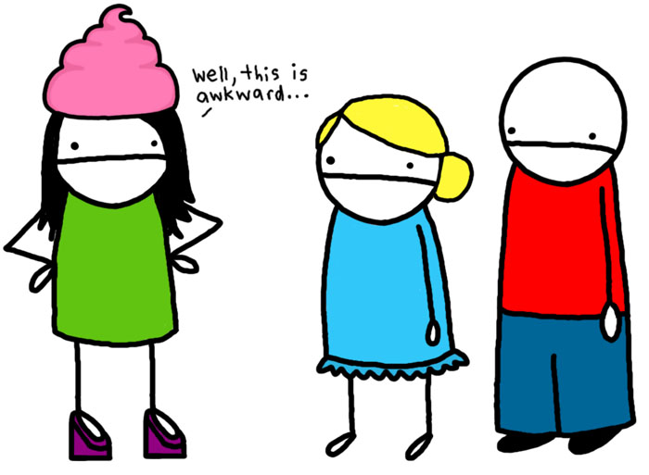
Notes:
or the spontaneous act may fall flat

Slide 24

What is your Primary Language?
Now think about which language you most prefer. What might others do to make you feel appreciated and valued in your job?
This is your primary language.
Notes:
Do the Quiz. Go to the flip chart that represents your top language. If you have a tie for your primary language, then choose one.

Slide 25
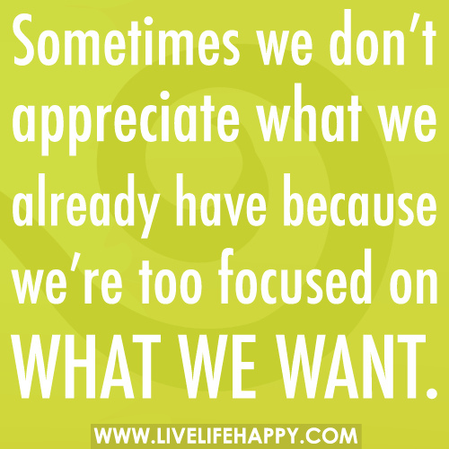
Answer the following question:
What about this language communicates appreciation to me?
Notes:
After everyone is finished, have them share their language and how that language communicates appreciation to them.
?Ask about why this quote might have been chosen…are we ever so focused on what we have to do and get done that we forget about everyone else around us???

Slide 26
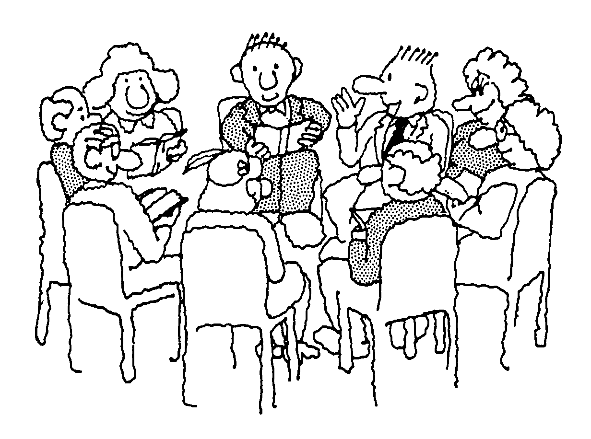
How can you use this with your agencies?
How you can discover the languages of appreciation with your volunteers?
How you can appreciate and value the volunteers in your agency, individually and/or as a team?
Notes:
Hand out paper to each person and start by completing this activity alone and answering the questions specifically about your department.
How you can discover the languages of appreciation in your agency?
How you can appreciate and value the volunteers, individually and/or as a team?
Get into groups and discuss what you came up with
Give each group a poster and markers to write their answers down. They will share with the whole group when everyone is finished.

